Slide 1

Title: AI-Powered Smart Shopping Assistant
BY: A b d u l l a h F r e h a t.
Ahmad ZainAlabdin
Ahmad Alsardi
SW Development & Documantation
Supervisor:
Dr. Ala Ali Abuthawabeh

Slide 2
Introduction – AI-Powered Smart Shopping Assistant
This project introduces an innovative Smart Shopping Assistant that leverages Artificial Intelligence to personalize the shopping experience. By analyzing user preferences, shopping patterns, and browsing history, the assistant recommends products that are most relevant to each individual. It acts like a digital personal shopper.

Slide 3
Problem Statement
The overwhelming amount of options available on e-commerce platforms leads to decision fatigue and a frustrating user experience. Customers often waste time searching and may abandon their shopping. There is a growing need for systems that simplify product discovery using smart filtering and intelligent guidance.

Slide 4
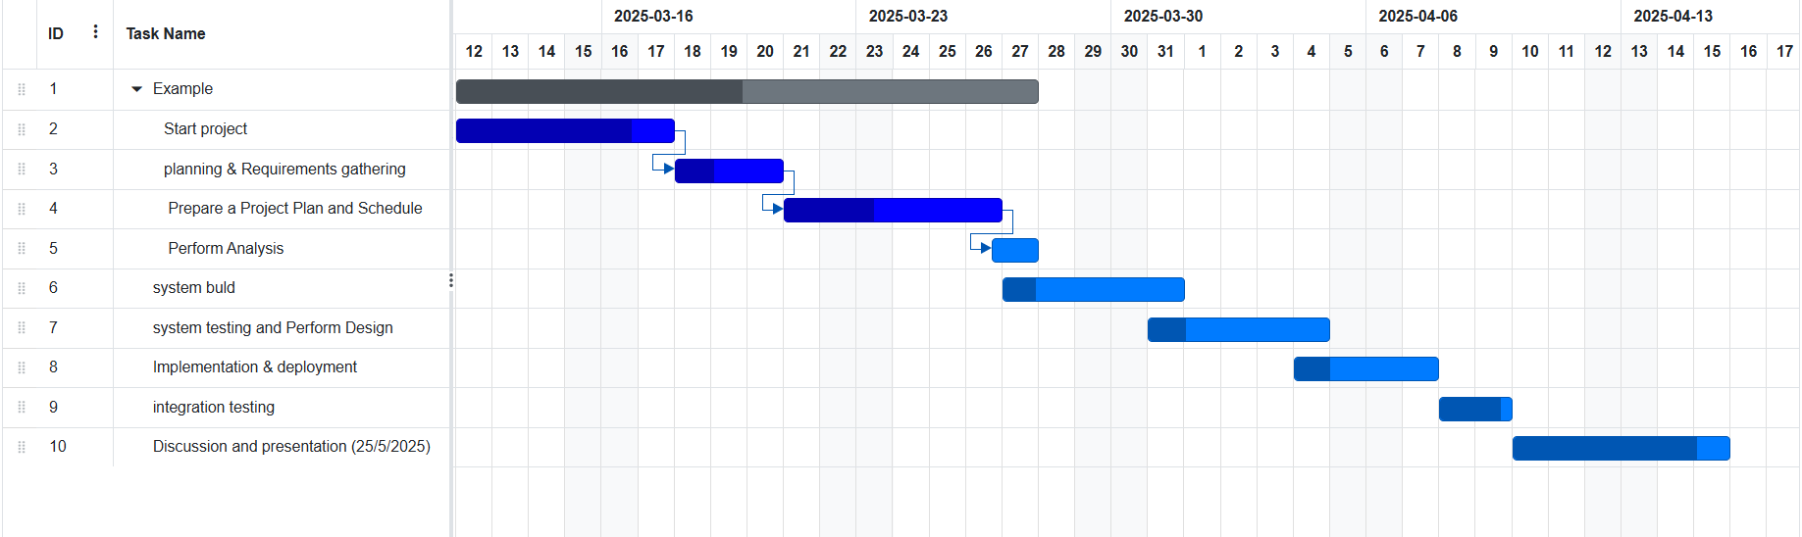

Slide 5
Project Objective
The main goal is to enhance the online shopping experience using AI. The assistant will use a trained model to analyze user data and offer real-time, accurate recommendations. It aims to increase user satisfaction, boost sales conversions, and reduce time spent searching for products.

Slide 6
System Overview
The assistant works by tracking user actions such as clicked products, time spent browsing, and preferences like categories and price ranges. These signals are sent to an AI model, which processes them and returns a set of recommended items. The system adapts to each user over time.

Slide 7
Key Features
- Dynamic product recommendations personalized per user
- Uses AI to detect preferences and behavior patterns
- Seamless integration with any online store backend
- Modular, scalable, and easy to update or extend

Slide 8
System Architecture
The application follows the Model-View-Controller (MVC) design pattern. The View is the user interface (UI), the Controller handles user actions and communication, and the Model processes data and includes the AI recommendation engine. This separation ensures clean, maintainable code and flexibility.

Slide 9
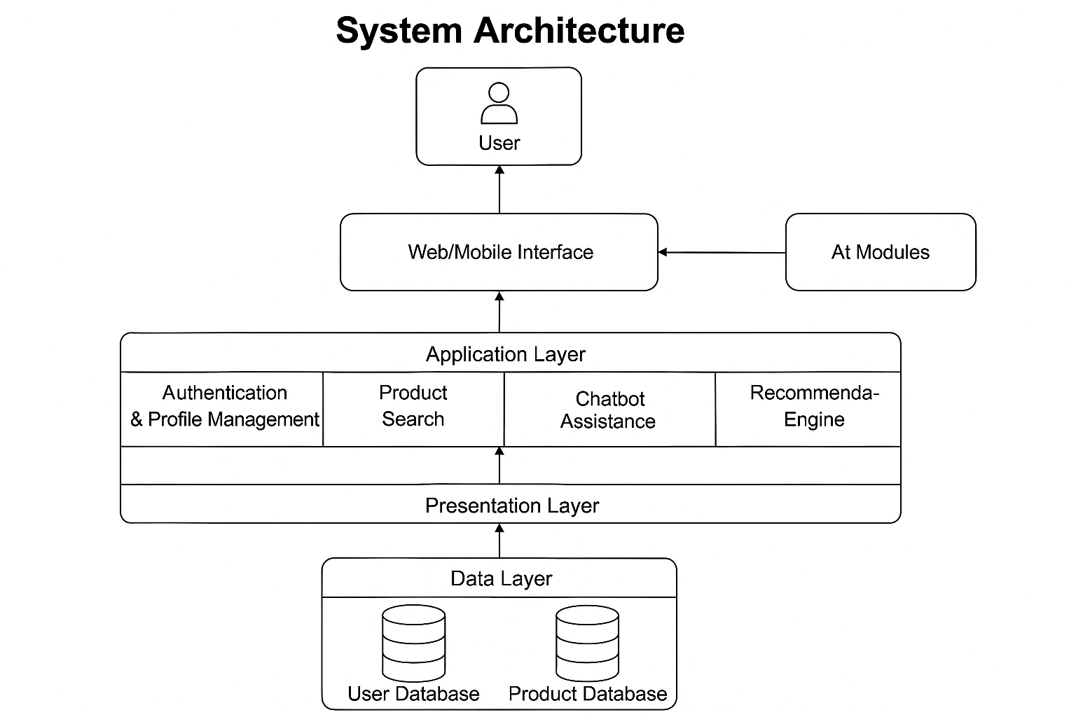
The diagram illustrates a layered architecture for the AI-Powered Smart Shopping Assistant
. The Presentation Layer (View) includes the Web/Mobile Interface that interacts directly with the user. The Application Layer represents the Controller, managing user requests through modules such as Authentication, Product Search, Chatbot Assistance, and the Recommendation
The Data Layer represents the Model, handling all data operations through the User and Product databases. This MVC structure ensures clear separation between interface, logic, and data, enhancing maintainability and scalability.

Slide 10
AI Model
The AI model is trained using datasets that include user behaviors, ratings, and purchase history. Algorithms such as collaborative filtering or neural networks help predict items the user may like. The model continuously improves using feedback and updated data.

Slide 11
Example Use Case
Imagine a user often buys fitness products and looks at running shoes. The assistant will suggest items such as sportswear, fitness gadgets, or similar shoes trending among other users. The suggestions become more accurate the more the user interacts with the system.

Slide 12
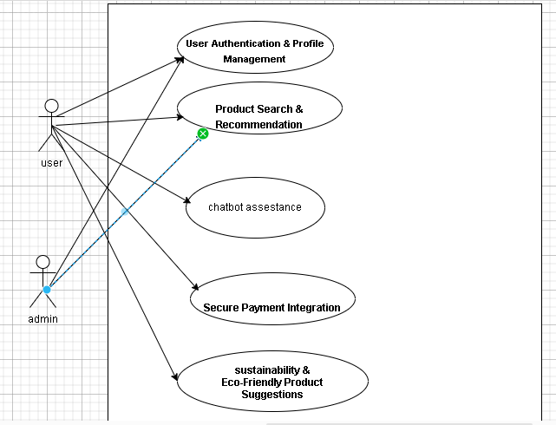

Slide 13
Technologies Used
- Java (object-oriented programming for core logic)
- JUnit (automated unit testing)
- Trained AI model (Java-based)
- Git for version control and collaboration

Slide 14
Development Methodology
The project follows SDLC phases: planning, analysis, design, implementation, testing, and maintenance. We used UML diagrams for planning, Gantt charts for scheduling, and documentation for each development stage to ensure smooth progress and clarity.

Slide 15

UI

Slide 16


Slide 17
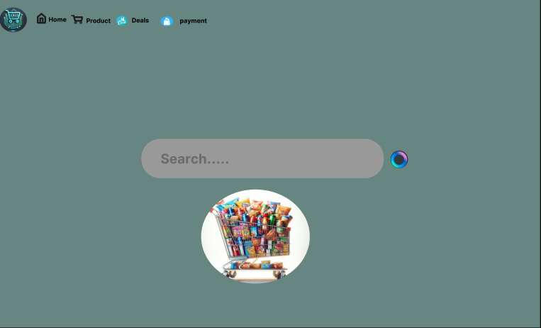

Slide 18
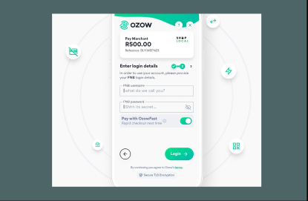

Slide 19
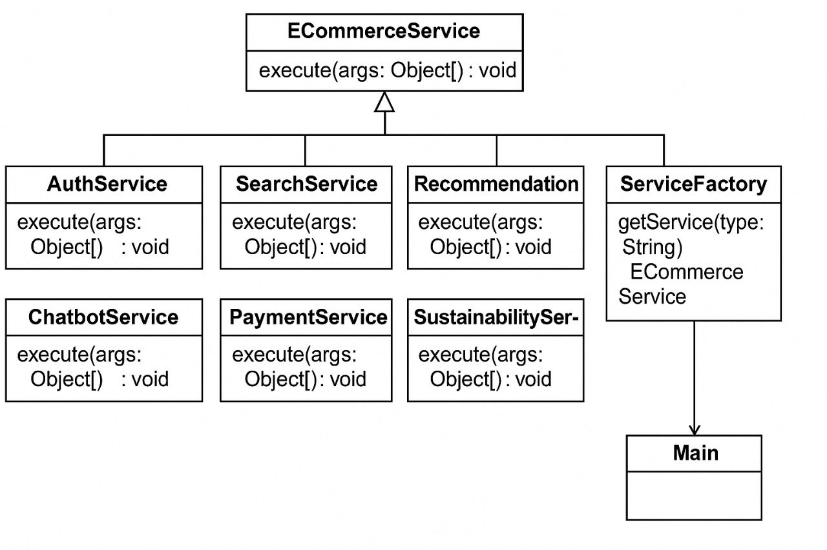
UML :ECommerceService

Slide 20
CODE
// Interface
public interface ECommerceService {
void execute(Object... args);
}
// Service implementations
public class AuthService implements ECommerceService {
@Override
public void execute(Object... args) {
String username = (String) args[0];
String password = (String) args[1];
System.out.println("Login: " + username);
}
}
public class SearchService implements ECommerceService {
@Override
public void execute(Object... args) {
String query = (String) args[0];
System.out.println("Search for: " + query);
}
}

Slide 21
public class RecommendationService implements ECommerceService {
@Override
public void execute(Object... args) {
String userId = (String) args[0];
System.out.println("Recommendations for user: " + userId);
}
}
public class ChatbotService implements ECommerceService {
@Override
public void execute(Object... args) {
String message = (String) args[0];
System.out.println("Chatbot response to: " + message);
}
}

Slide 22
public class PaymentService implements ECommerceService {
@Override
public void execute(Object... args) {
String method = (String) args[0];
int amount = (Integer) args[1];
System.out.println("Payment of $" + amount + " using " + method);
}
}
public class SustainabilityService implements ECommerceService {
@Override
public void execute(Object... args) {
String userId = (String) args[0];
System.out.println("Sustainable suggestions for user: " + userId);
}
}

Slide 23
// Factory class
public class ServiceFactory {
public ECommerceService getService(String type) {
switch (type) {
case "auth": return new AuthService();
case "search": return new SearchService();
case "recommend": return new RecommendationService();
case "chat": return new ChatbotService();
case "payment": return new PaymentService();
case "sustain": return new SustainabilityService();
default: throw new IllegalArgumentException("Unknown service type.");
}
}
}

Slide 24
// Main class using only the factory
public class Main {
public static void main(String[] args) {
ServiceFactory factory = new ServiceFactory();
factory.getService("auth").execute("ali", "12345");
factory.getService("search").execute("organic shoes");
factory.getService("recommend").execute("user_01");
factory.getService("chat").execute("What are the most eco-friendly sneakers?");
factory.getService("payment").execute("paypal", 199);
factory.getService("sustain").execute("user_01");
}
}

Slide 25
Challenges & Solutions
Challenges included handling complex and changing user behavior, training the model with diverse data, and ensuring performance at scale. We overcame these by designing modular components, using scalable infrastructure, and continuously testing model accuracy.

Slide 26
Conclusion
The AI-Powered Smart Shopping Assistant is a modern solution to the problems of e-commerce navigation. By using AI to understand users, it makes shopping faster, easier, and more satisfying. It holds great potential for future enhancements like voice commands and integration with smart devices.

